Slide 1
Home In Tacoma Project
Permit Adv Group
June 21, 2023
Notes:
STEVE -
Want to be clear about the timing/sequencing (fact sheet coming soon)
In 2024 – new rules in place

Slide 2
Agenda
Review and discuss
Round 2 Engagement (Council District meetings) outcomes to date
Adjustments to the Home In Tacoma – Phase 2 initial zoning and standards
Updated project schedule

Slide 3
Home In Tacoma Open House Events
Learn and share your views on how to get middle housing right
May 22nd District 4 at Stewart Middle School
May 25th District 2 at Meeker Middle School
June 1st District 3 at Tacoma Community House
June 7th District 1 at Swasey Library
June 8th District 5 at Fern Hill Library
June 14th Virtual Meeting
June 22nd North Tacoma at Mason Middle School
June 26th South Tacoma at STAR Center
OUTCOMES:
Councilmembers at in-person meetings
Inter-departmental staff participation
Housing Equity Champions support
Language access prioritized
Positive feedback on our effort to engage

Slide 4
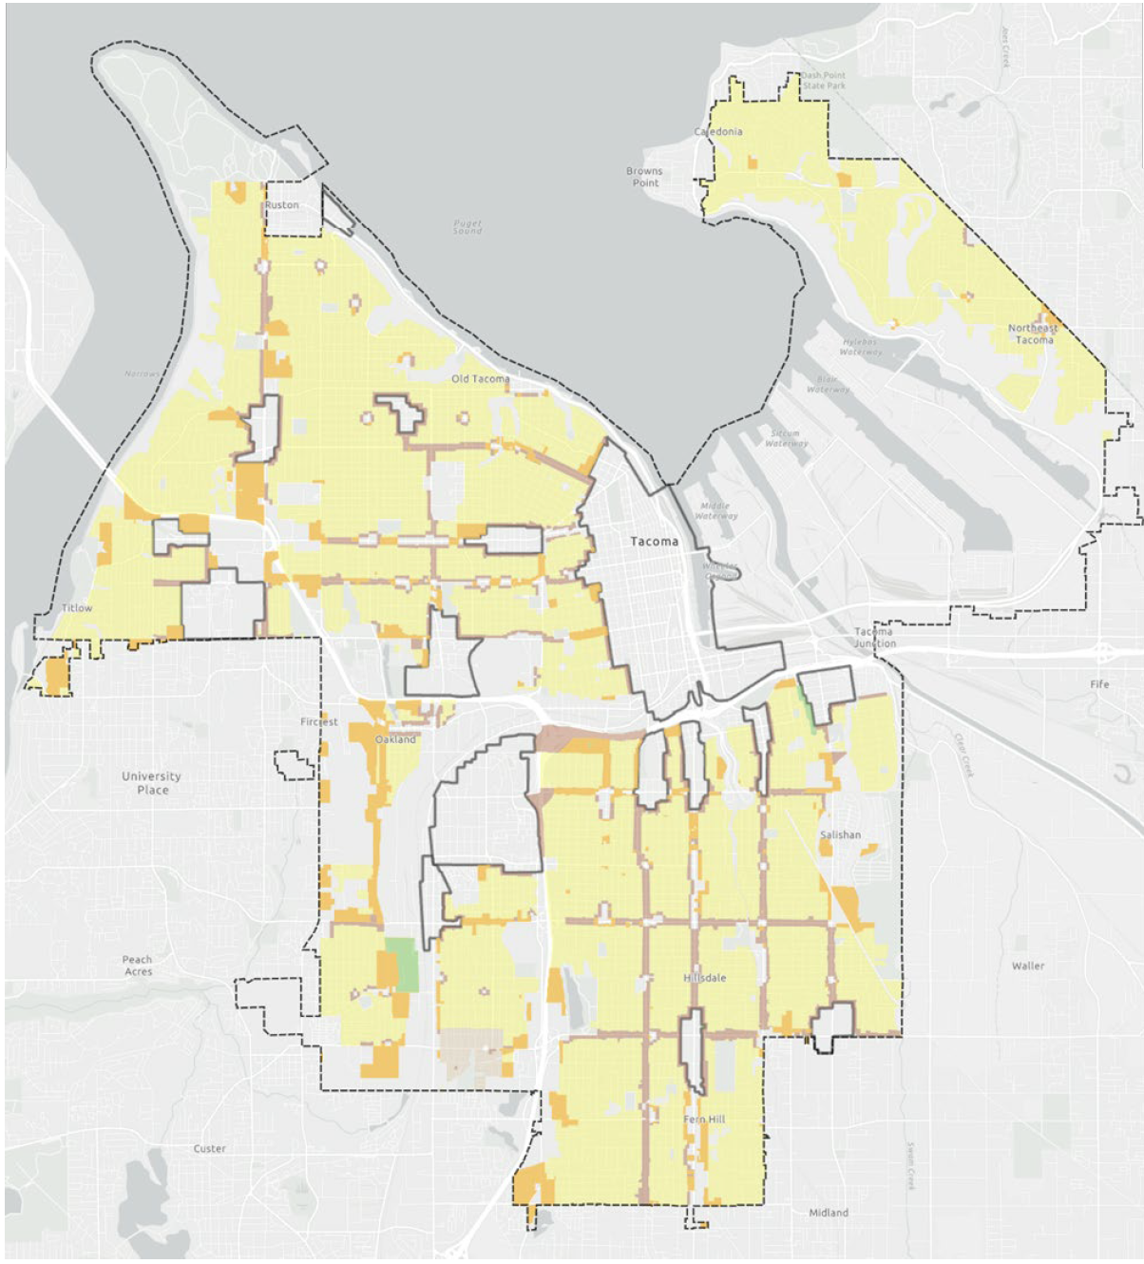
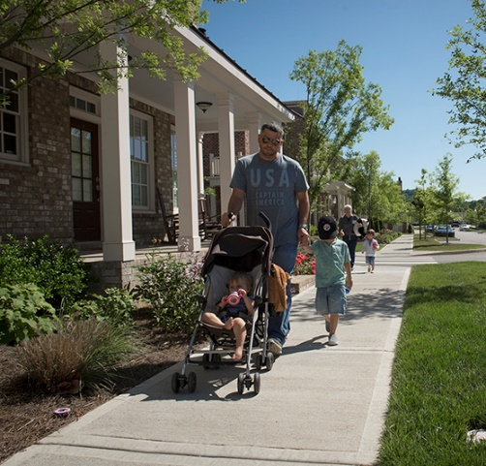
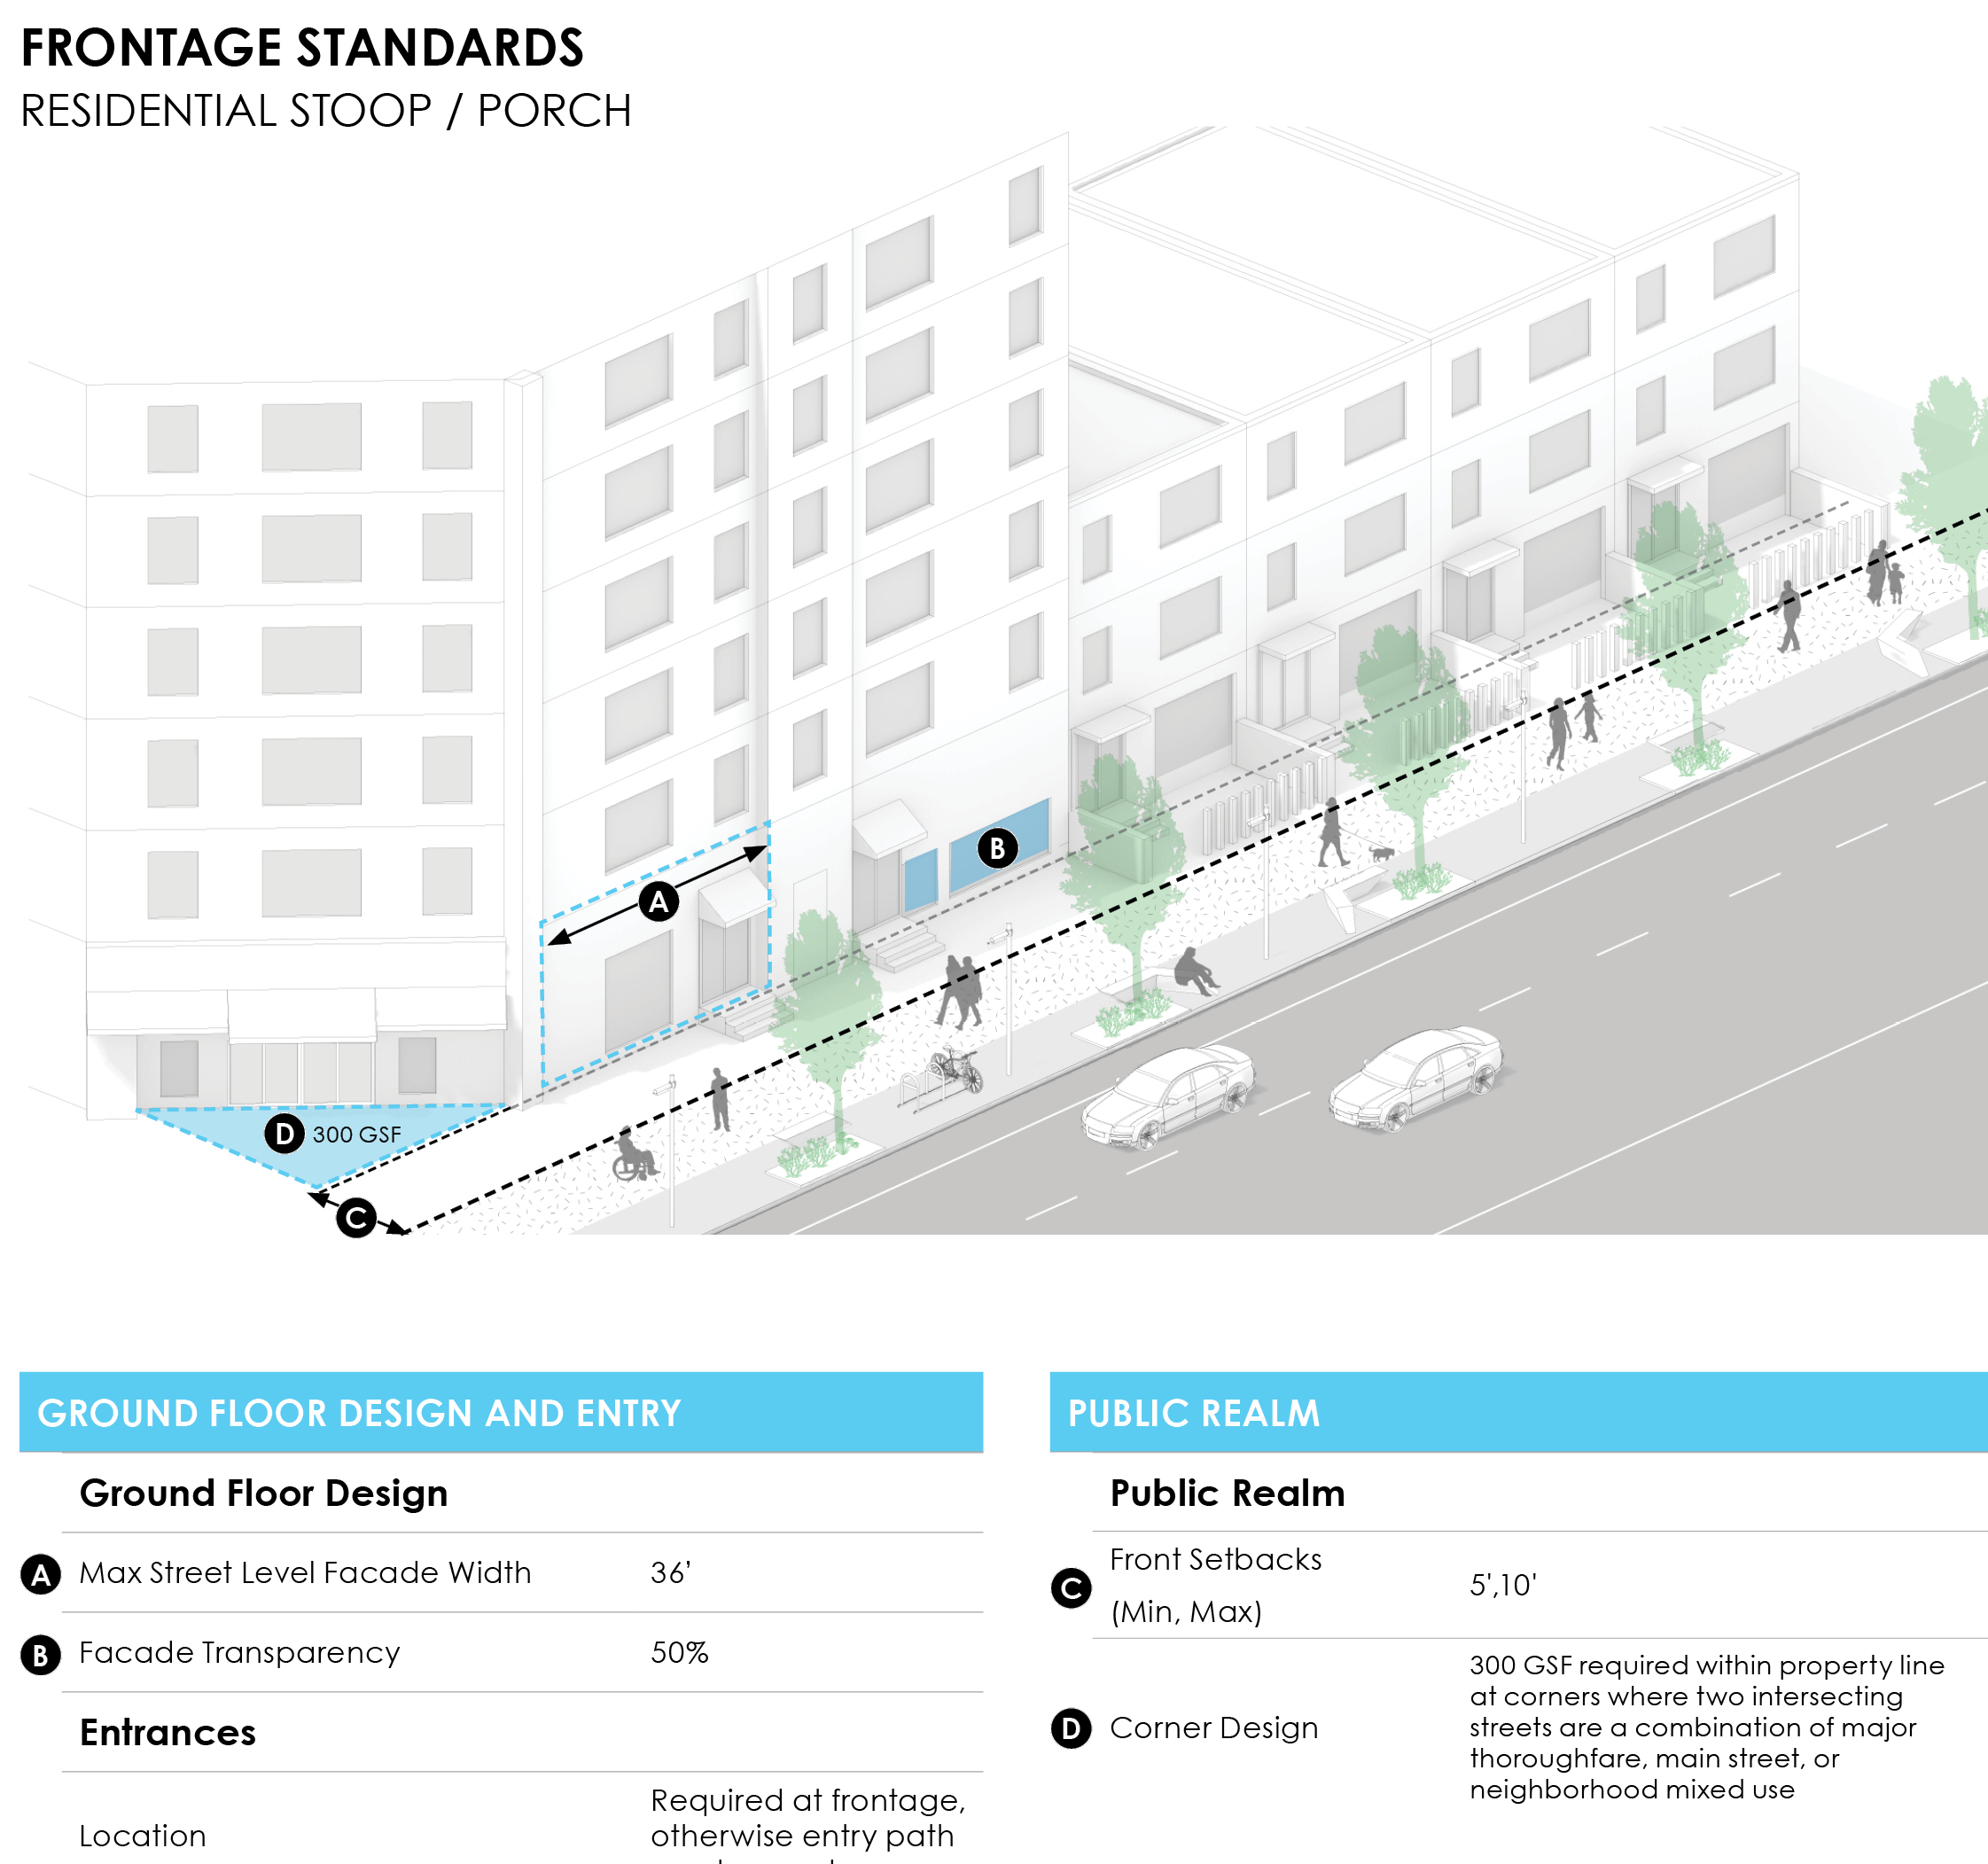
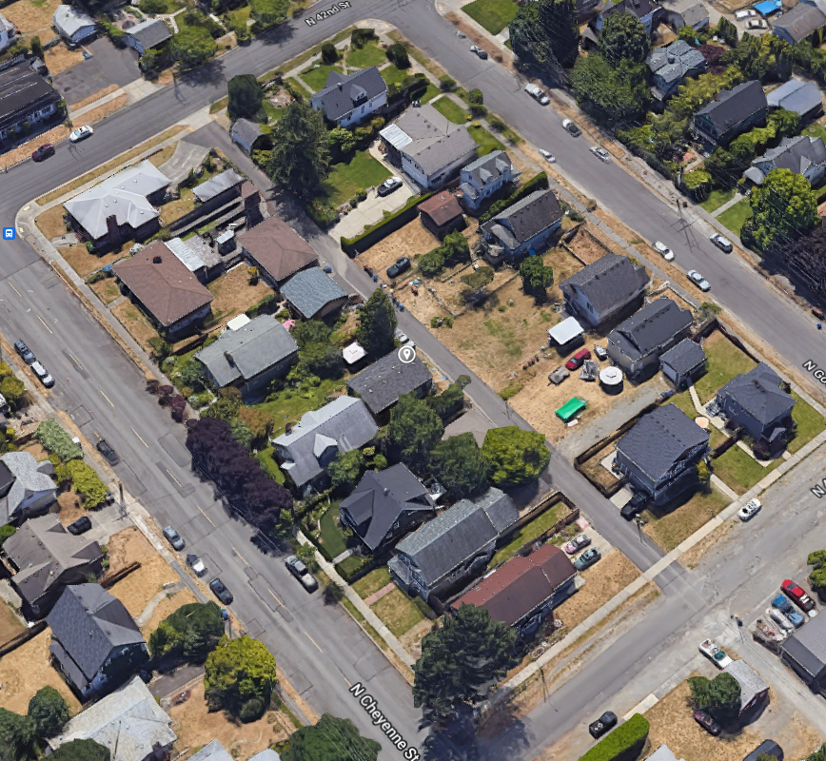
Council and Commission direction to date for zoning framework
Meet Tacoma's newly adopted housing growth vision
Use development scale as organizing characteristic​
Prioritize walkability, transit, cycling and complete neighborhoods
Create predictable, flexible regulations and requirements
​​​​
Reflect neighborhood patterns such as yards, building scale, height ​​​
​​​
Notes:
Use development scale as organizing characteristic
Development density/intensity and scale transition upwards with proximity to walkable, transit-ready areas
Avoid out-of-scale, jarring scale transitions
Focus on future zoning envelope to allow for change over time
Differentiate based on infill vs large site for Mid-scale (mid-scale infill to have limited maximum street frontage)
Continue to prioritize "complete neighborhoods" and walkability
More housing capacity nearest to walkable/transit ready areas
Has associated affordability benefits as well as reduced costs for households
Supports our 20-minute neighborhood growth vision, equity and access to opportunity, sustainability, transportation choices
Reflect neighborhood patterns such as yards, building scale, height
Height and scale already allowed under zoning (typ. Up to 3 stories)
Street layout – alley vs front loaded, grid vs curvilinear
Lot sizes and widths
Era of development
Promote predictability and logical property divisions and ownership opportunities, and provision of infrastructure, access
Don’t create too many zones for clarity and predictability
Determine access requirements
Retain the use of critical areas standards, view/historic overlays to address govern specific features (as opposed to many different zoning districts)

Slide 5
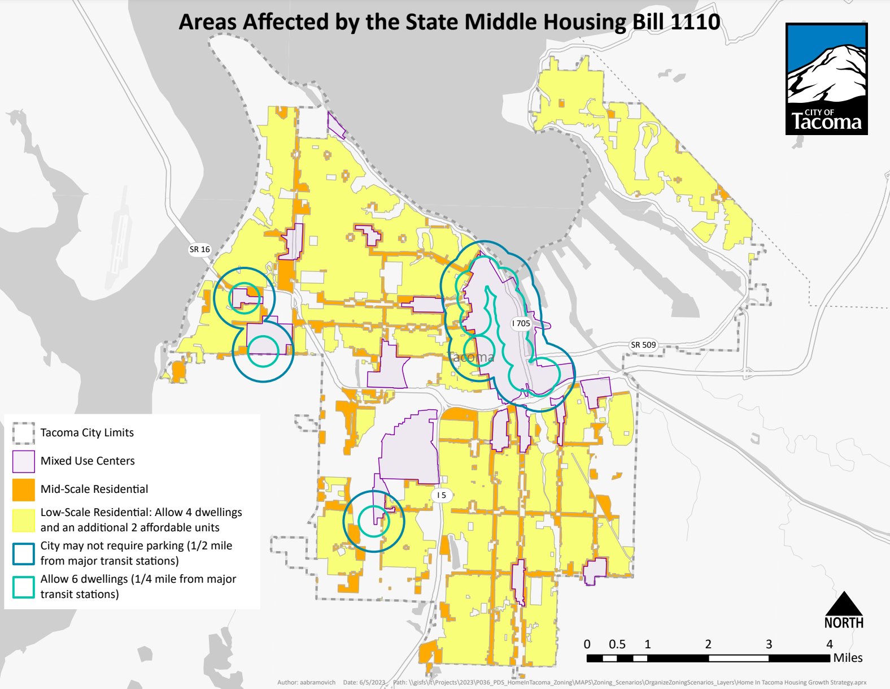
Key HB 1110 and Home In Tacoma
Allow 4 dwellings per lot (2 more affordable)
Allow 6 dwellings per lot (¼ mile of major transit stations)
No parking requirements (½ mile of major transit stations)

Slide 6
Adjustments to HIT initial zoning package
Low-scale Residential:
Low-scale 1: Increase from 3 to 4 dwellings per lot
Low-scale 2: Increases from 4 to 6 dwellings per lot
Bonuses: Additional 2 affordable units allowed in both districts
Mid-scale Residential:
Increase density from 6 to 8 dwellings per lot
Bonuses (along Corridors): Additional density + 4th floor
Redoing growth estimates to support the EIS

Slide 7
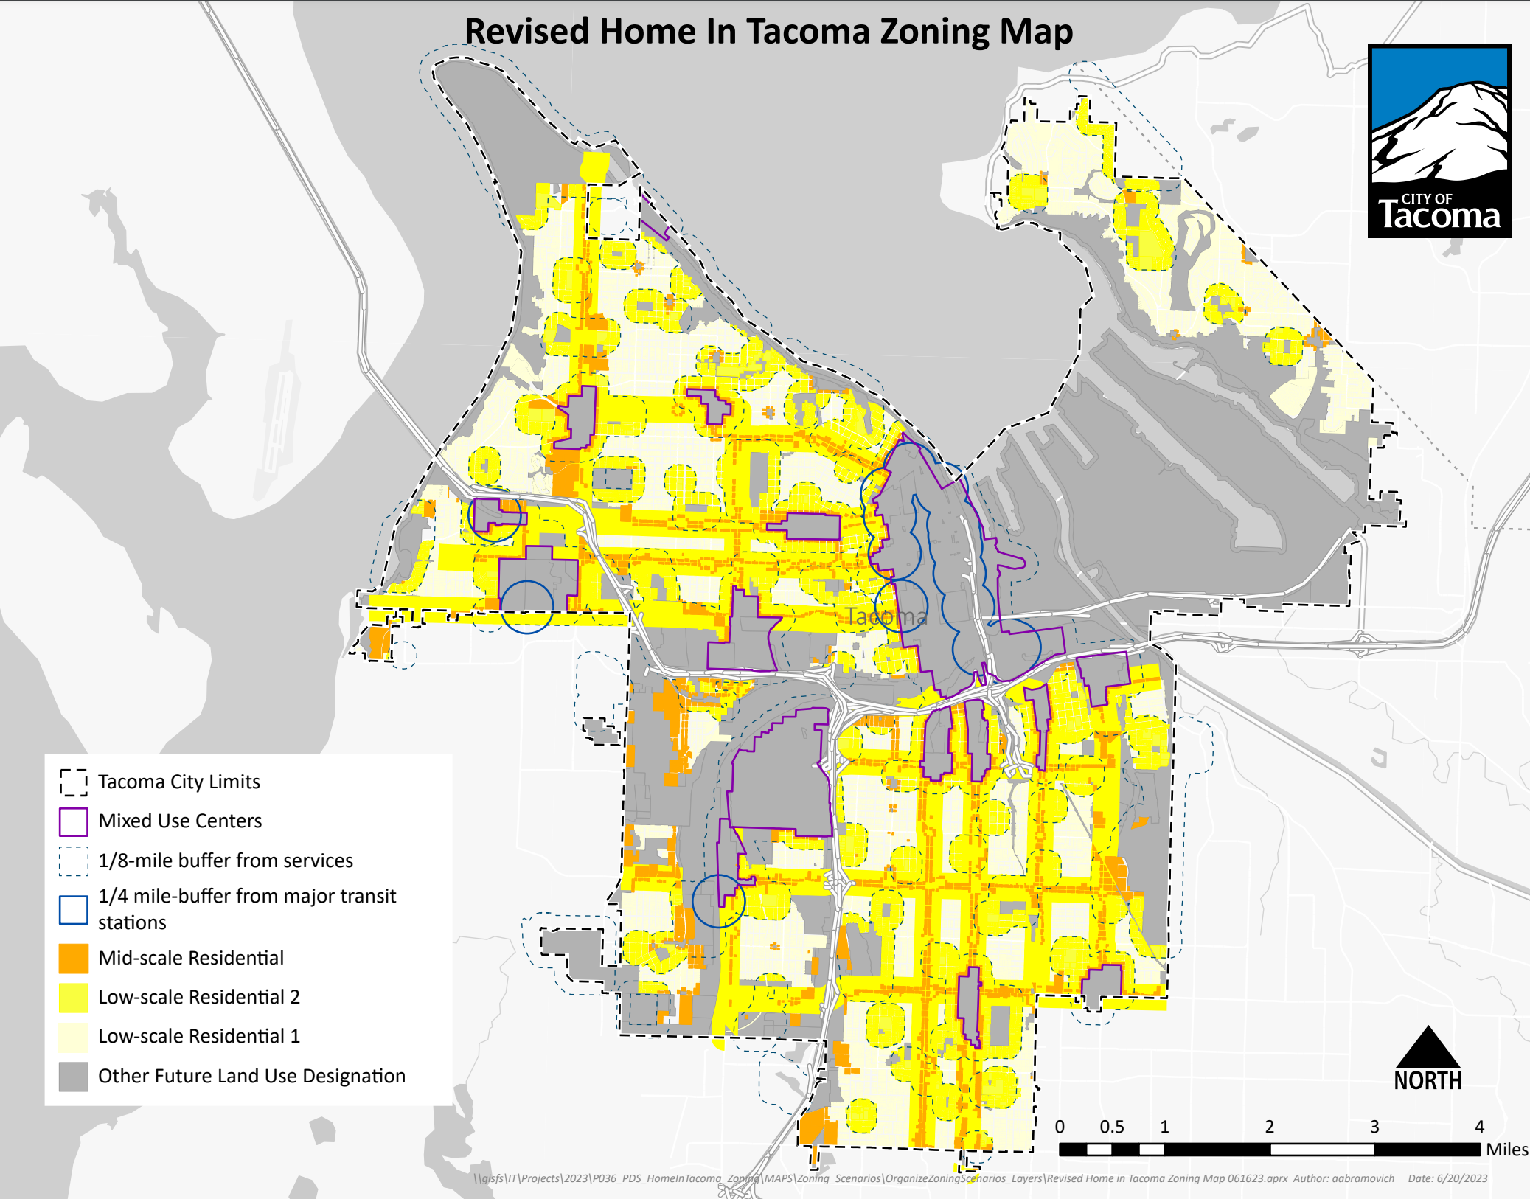
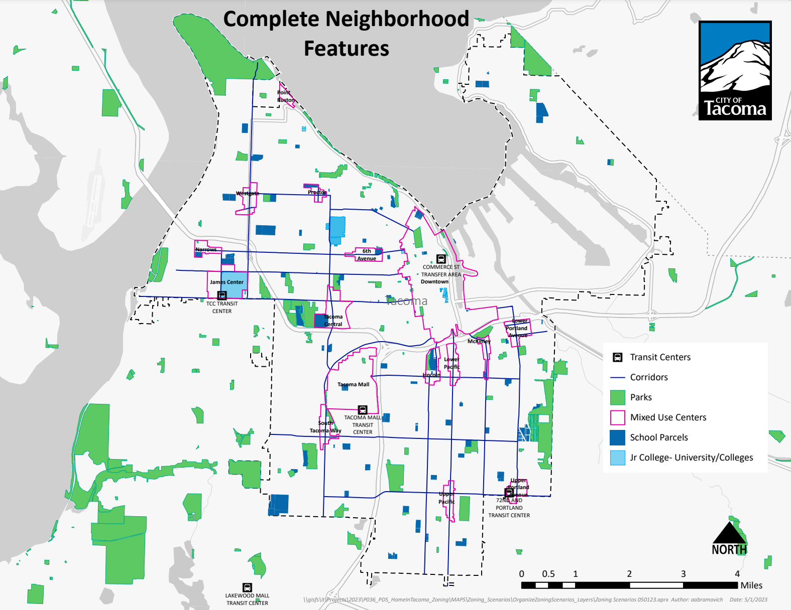
Adjustments to HIT initial zoning package (CONT)
Low-scale Residential 2
1/4-mile of “major transit stations” (per HB 1110)
1/8-mile of “complete neighborhood features” (per HIT policy direction)
DRAFT

Slide 8
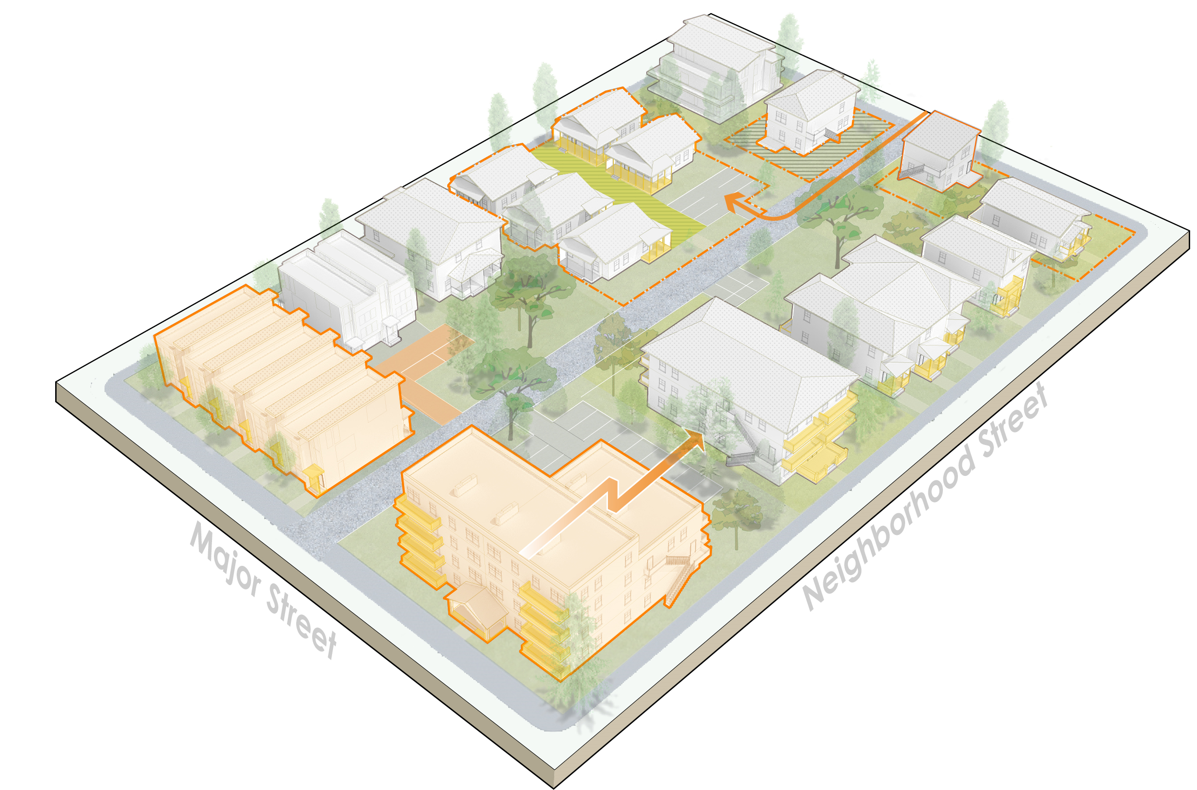
Other adjustments (standards, bonuses)
Initial standards concepts largely consistent with state direction
More flexibility (such as reduced lot size, setbacks, parking requirements)
Prioritize compatibility (such as building scale, housing type standards, trees, yard standards
KEY STATE DIRECTION: Parking, ADU standards, separate ownership of units, SEPA process and more
Initial affordability/bonus concepts also largely consistent
Bonuses: Scale and density are the most valuable
Public Benefits: Affordability, short list of others
KEY STATE DIRECTION: +2 affordable units in Low-scale; affordability levels, duration
Notes:
Phase 1 direction
About priorities; balance….
Over the next couple of months-
Establish the big moves (such as – are we increasing tree requirements?; options to encourage reusing existing buildings? How big will new buildings be?)
There will be tradeoffs with housing development and cost
By the Mar-April neighborhood meetings will have a package to react to

Slide 9
Revised project schedule
July to Oct 2023
Nov 2023 to Jan 2024
Feb to April 2024
Develop full package
EIS Consultation
TOPICS:
Finalize zoning map
Middle Housing design package
Parking, trees and yard space
Land uses, discretionary permits, definitions
Affordability and bonuses
Planning Commission Public Hearing
Release Draft EIS
Planning Commission recommendation
City Council review
Release Final EIS
Council Public Hearing
Council action
Ongoing engagement throughout

Slide 10
Zoning actions
Zoning framework: Form-based system based on density, scale and housing types; optional bonuses
Middle Housing zoning districts
Zoning map: Directly implements Phase 1 map; higher density & scale near walkable features
Other areas zoned single-family (such as Parks and Open Space): Zone to Low-scale 1; establish a Passive Open Space Overlay District to protect natural areas
View Sensitive Districts: Potential East Tacoma Expansion (McKinley and Roosevelt Ave areas)
Land uses: Simplify list; reflect middle housing types; allow limited non-residential in Mid-scale
Planned Residential Districts (PRDs): Determine how adopted PRDs will fit in new zoning system
Actions for consistency with State law: Reflect 2023 bills (ex: minimum densities)

Slide 11
Standards
Height: 35 feet (potential 45 feet in Mid-scale); varies by housing type
Scale: Floor Area Ratio (linked to number of units), building width/depth, yard requirements
Lot standards: Allow lots down to 2,500 square feet; smaller “pocket” lots can be sold separately
Setbacks: Front setbacks reduced from 20 to 15 feet in Low-scale, 10 in Mid-scale
Pedestrian and vehicular access: Pedestrian-oriented features face street, cars in rear lot
Parking: Reduced from 2 per dwelling to 1, with reductions for transportation choices
Trees/landscaping: Street trees and onsite tree canopy required, evaluate options for flexibility
Building orientation and design features: Promote compatibility, pedestrian orientation
Adaptive reuse/historic preservation, Physical accessibility, Green building: Promote with bonuses
Definitions, discretionary permits, Special Needs Housing, Short-term Rentals: Integrate the new zoning framework, remove housing barriers
Tiny, modular and mobile homes: Remove land use code barriers
Actions for consistency with State law: Reflect 2023 bills (ex: parking)

Slide 12
Affordability
General guidance and objectives
Affordability is a top priority, but other public goals could be supported
Value of bonuses must be commensurate with the cost of the public benefit: Revise fee in lieu; reduce “by-right” scale for detached single-family; target both non-profit and for-profit developers
Use the Equity Index to target bonuses based on neighborhood priorities
What development bonuses to offer: Density in combination with scale, potentially parking reductions
What public benefits could be promoted: Affordable housing units; physically accessible (visitable) units; family-sized units; retention of existing structures while adding units; green features
Structure of bonus program: Reduce “friction” for users; prepare for administrative burden; set parameters such as income targets, term of affordability, percentage of units, voluntary vs. mandatory
Relation to Multifamily Tax Exemption Program: MFTE extending to Mid-scale, Neigh. Commercial
Actions for consistency with State law: Reflect 2023 bills (ex: 4 to 6 units for affordability)

